Slide 1


4. Dataframes
Mrinal Vashisth
PhD Year 2, Computational Psychometrics, TSU, RF
M.Sc. Human Development: Genetics, Neuroscience and Psychology, TSU, RF
M.S. Applied Mathematics and Information Technology (Systems Biology and Bioinformatics), ITMO, RF
B.Tech. Biotechnology, JNU, RI

Slide 2
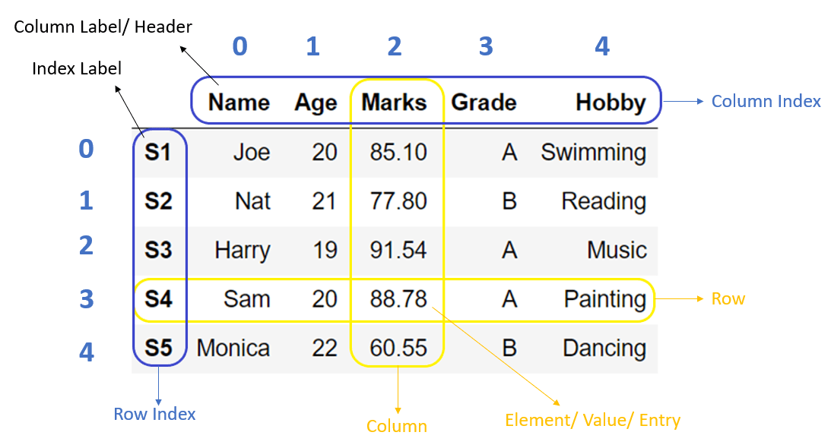
What are dataframes

Slide 3
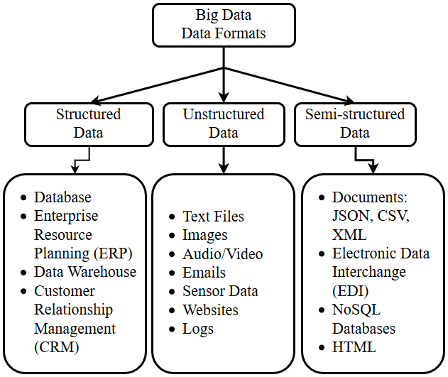
Data formats
Punn, Narinder & Agarwal, Sonali & Syafrullah, M. & Adiyarta, Krisna. (2019). Testing Big Data Application. 159-162. 10.23919/EECSI48112.2019.8976972.

Slide 4
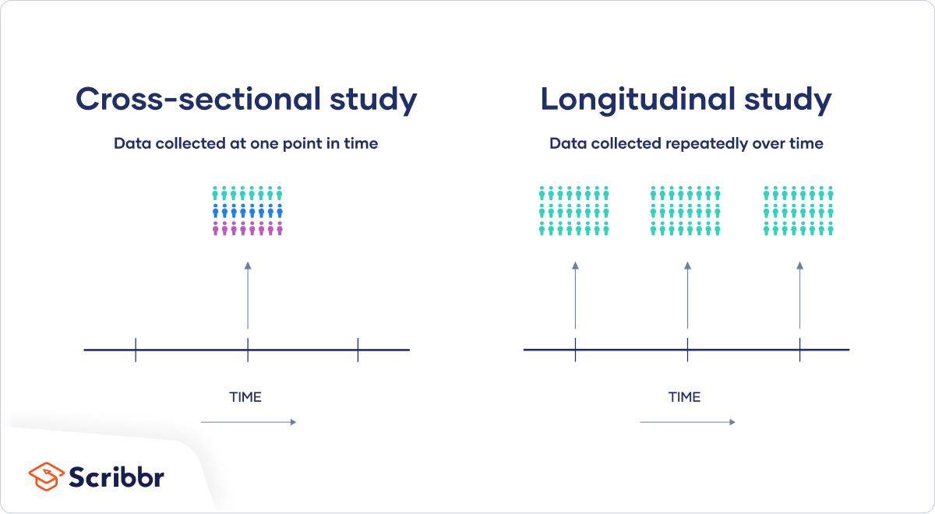
Statistics
https://www.scribbr.com/methodology/cross-sectional-study/

Slide 5
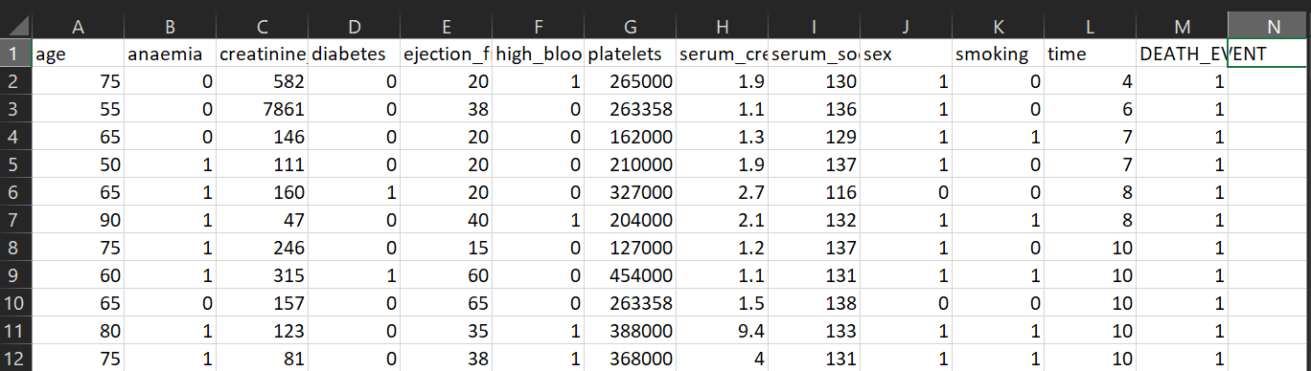
Example: Prediction models
https://www.kaggle.com/code/rude009/heart-failure-model-prediction-comparisons-95/input

Slide 6
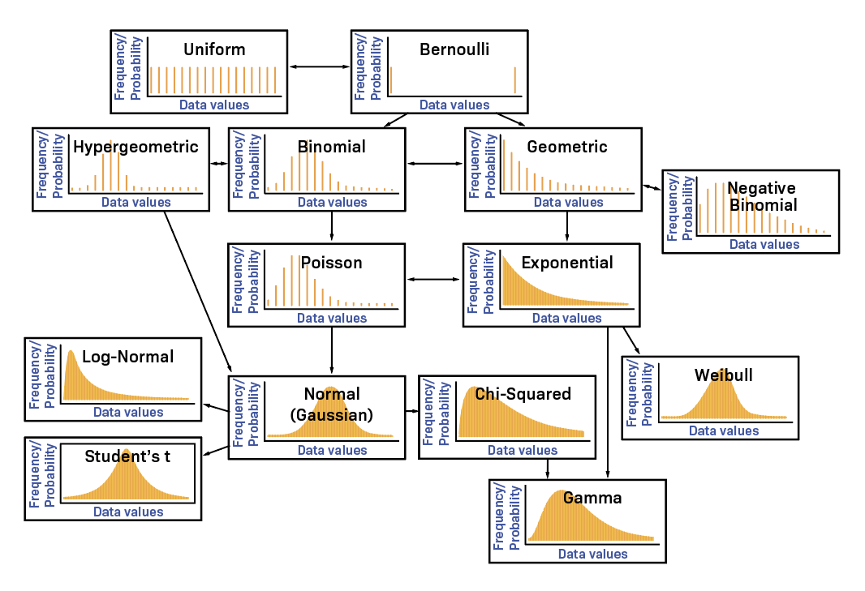
https://www.labxchange.org/library/items/lb:LabXchange:fdbe019c:html:1

Slide 7
Go to jupyter notebook 4.

Slide 8
Assignment
Apply PCA on the data about heart failure factors, using python, and make a PCA plot

